Slide 1

Tableau Project
911 - Emergency Call

Slide 2
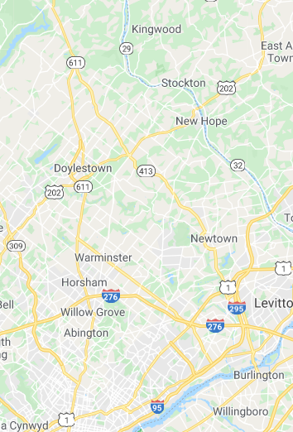
Info
About 911
Created by Congress in 2004 as the 911 Implementation and Coordination Office (ICO), the National 911 Program is housed within the National Highway Traffic Safety Administration at the U.S. Department of Transportation and is a joint program with the National Telecommunication and Information Administration in the Department of Commerce.
About Montgomery County
Montgomery County, locally also referred to as Montco, is a county located in the Commonwealth of Pennsylvania. As of the 2010 census, the population was 799,874, making it the third-most populous county in Pennsylvania, after Philadelphia and Allegheny Counties. The county seat is Norristown. Montgomery County is very diverse, ranging from farms and open land in Upper Hanover to densely populated rowhouse streets in Cheltenham.

Slide 3
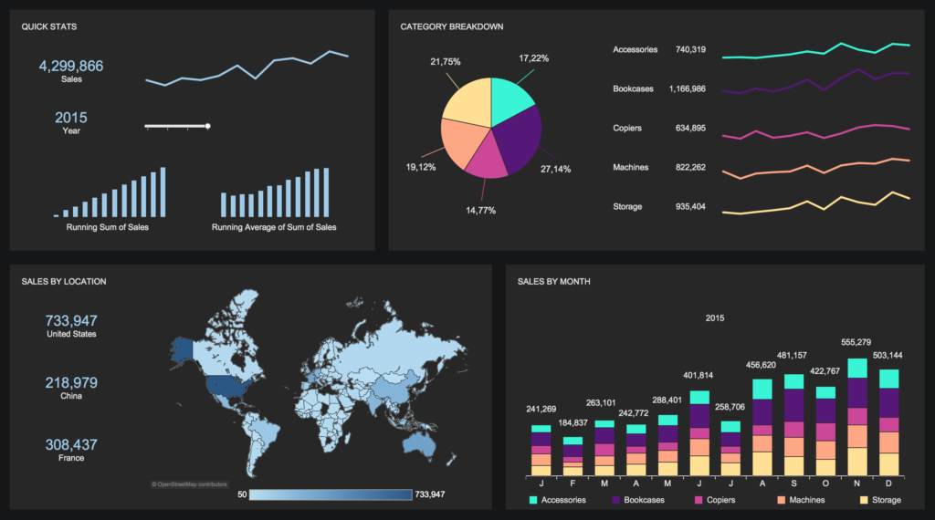

Agenda
This is data of emergency calls from Montgomery County, PA.
Duration of data is year 2015 to year 2020.
Let’s try to explore the dataset.

Slide 4
DATA
1

Slide 5
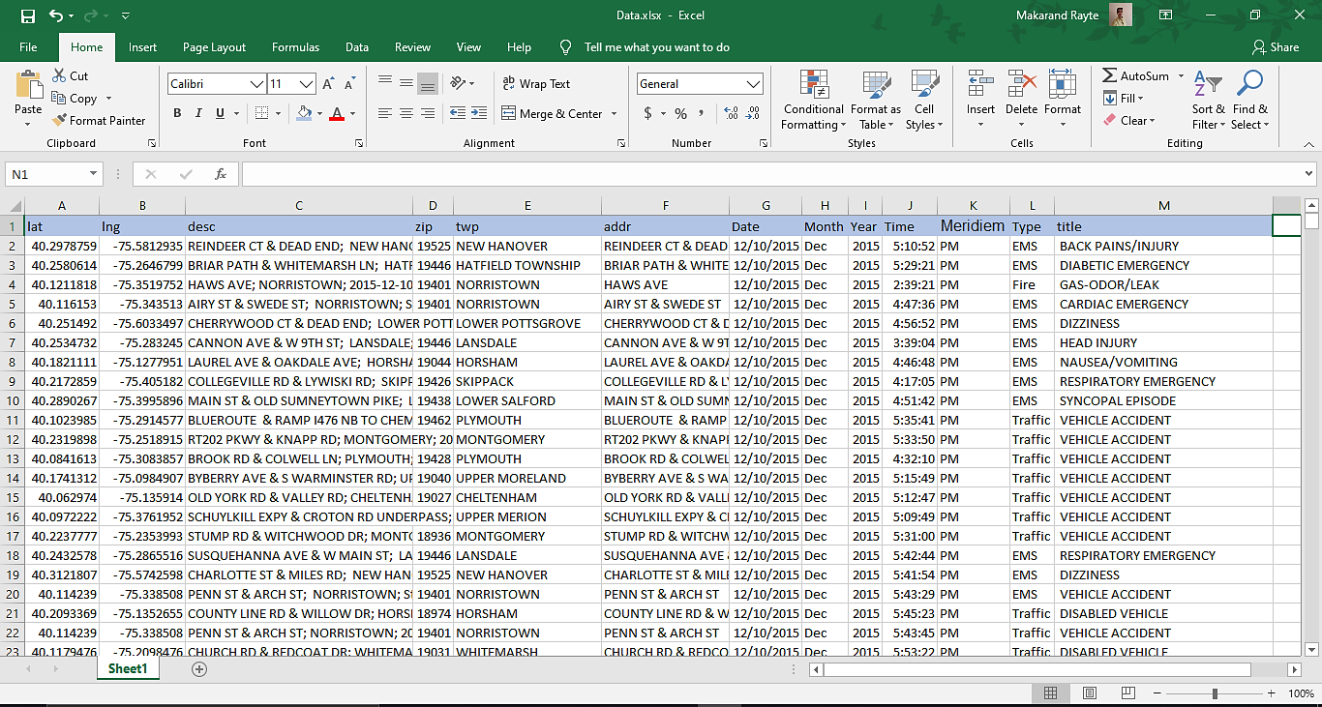

Slide 6


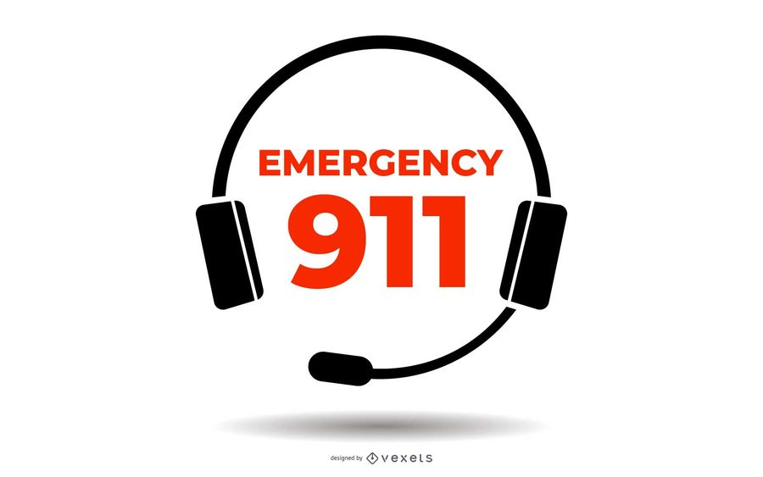

Attributes
Lat – Latitude zip - ZIP code
Lng – Longitude addr – Address
twp – Township desc – complete emergency description
Date Month
Year Time
Meridiem (AM/PM)
Description
Here we have describe various header attributes or columns of excel dataset.
Type – type of emergency
EMS (emergency medical services) / Traffic / Fire
Title – categorical description under Type

Slide 7
DASHBOARD
2

Slide 8
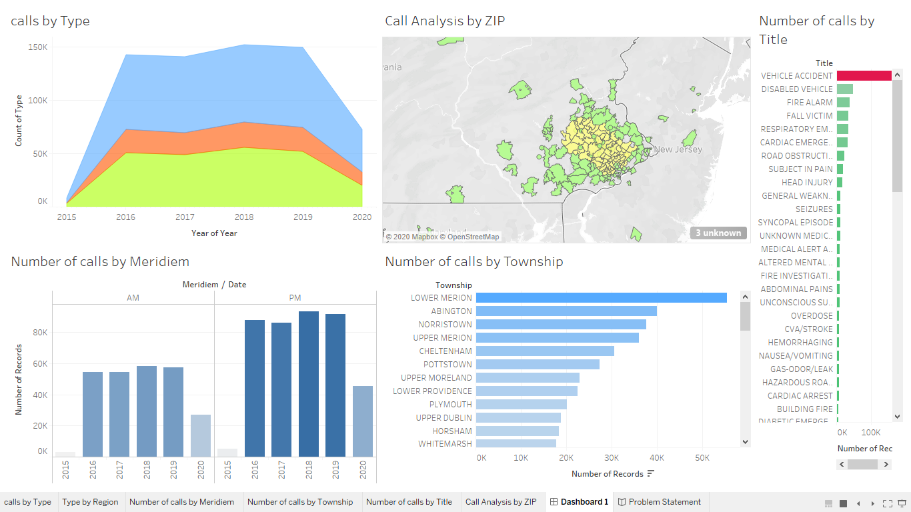

Slide 9
Problem Statement + Analysis
3

Slide 10
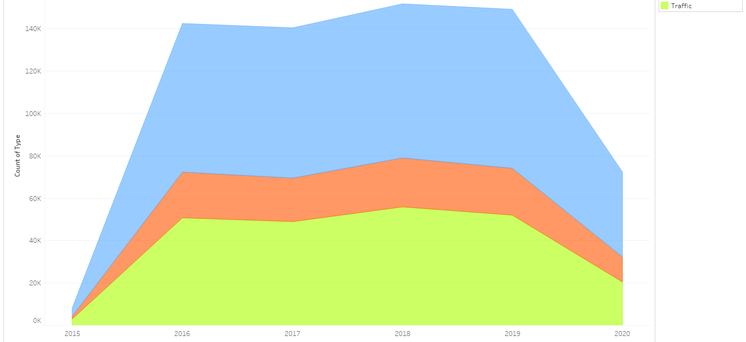
Problem Statement 1
Analysis
What is the main reason for calls ?
Try to compare number of calls by type?
Can you provide us total number of calls by type in year 2015 to 2020?
The main reason for calls are “EMS (emergency medical services)”
We can clearly see that we received maximum number of calls of EMS ,then for traffic , then for fire.
Table as below :
Type | 2015 | 2016 | 2017 | 2018 | 2019 | 2020 till July
EMS | 3,898 | 70,127 | 71,053 | 72,587 | 75,006 | 40,021
Traffic | 2,923 | 50,656 | 48,737 | 55,814 | 51,840 | 20,238
Fire | 3,898 | 21,577 | 20,553 | 23,126 | 22,272 | 11,999

Slide 11
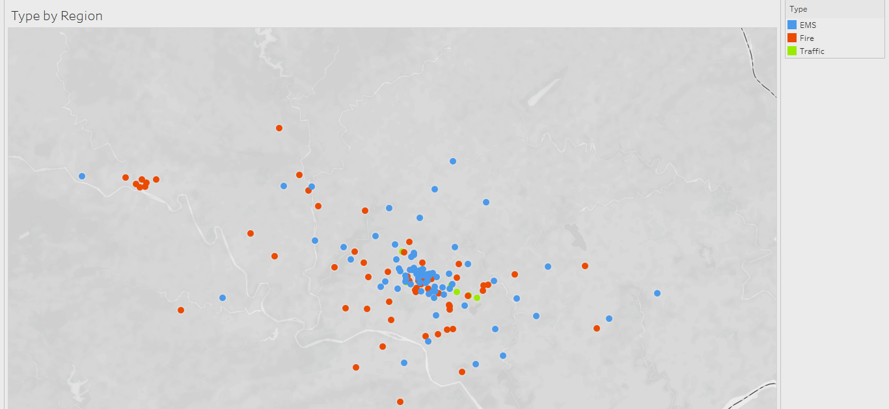
Problem Statement 2
Analysis
visualize the data by region for type?
Is it possible to tell us which region call us for EMS if we divide Montgomery County in parts (East/West/North/South/Center)
Yes , We can visualize data by region for type .
As per above report we can see most of the calls received from center region for EMS.

Slide 12
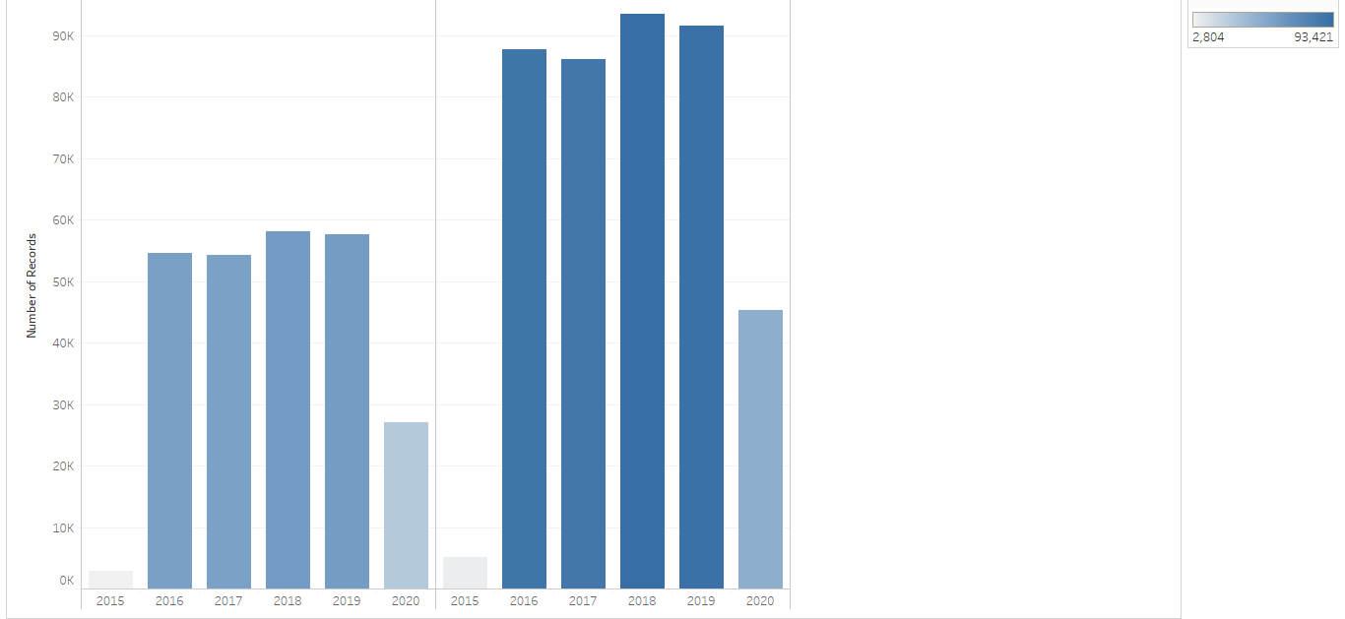
Problem Statement 3
Compare data with respect to meridiem?
Which meridium received frequent calls?
Which year received higher number of calls with respect to meridium?
Analysis
Shown as above report
PM meridium received frequent calls.
Year 2018 observed higher number of calls
AM →58,106
PM → 93,421

Slide 13
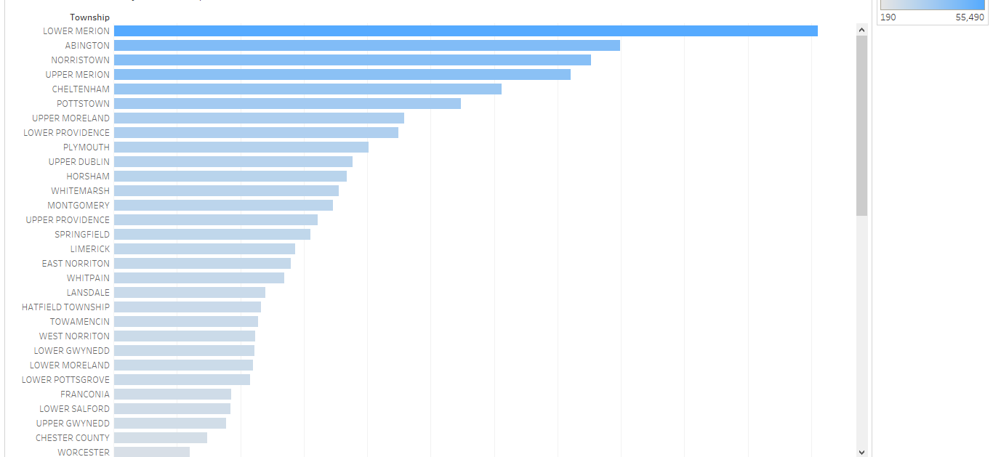
Problem Statement 4
List top 5 township for call ?
Which township is first in emergency call?
Analysis
The Table as below :
Township | Total Number of call
LOWER MERION | 55,490
ABINGTON | 39,947
NORRISTOWN | 37,633
UPPER MERION | 36,010
CHELTENHAM | 30,574

Slide 14
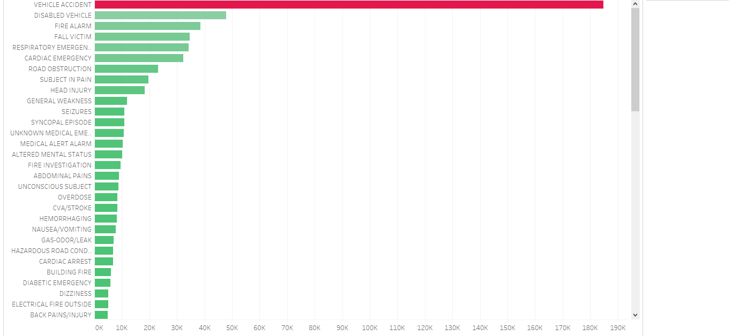
Problem Statement 5
Top 5 Most Emergency call ?
Top 5 Less Emergency call ?
Analysis
Most Emergency call |  | Less Emergency call
Reason | Number of calls | Reason | Number of calls
VEHICLE ACCIDENT | 184,749 | ANIMAL COMPLAINT | 1
DISABLED VEHICLE | 47,917 | FOOT PATROL | 1
FIRE ALARM | 38,452 | HIT + RUN | 1
FALL VICTIM | 34,683 | PRISONER IN CUSTODY | 1
RESPIRATORY EMERGENCY | 34,250 | ARMED SUBJECT | 2

Slide 15
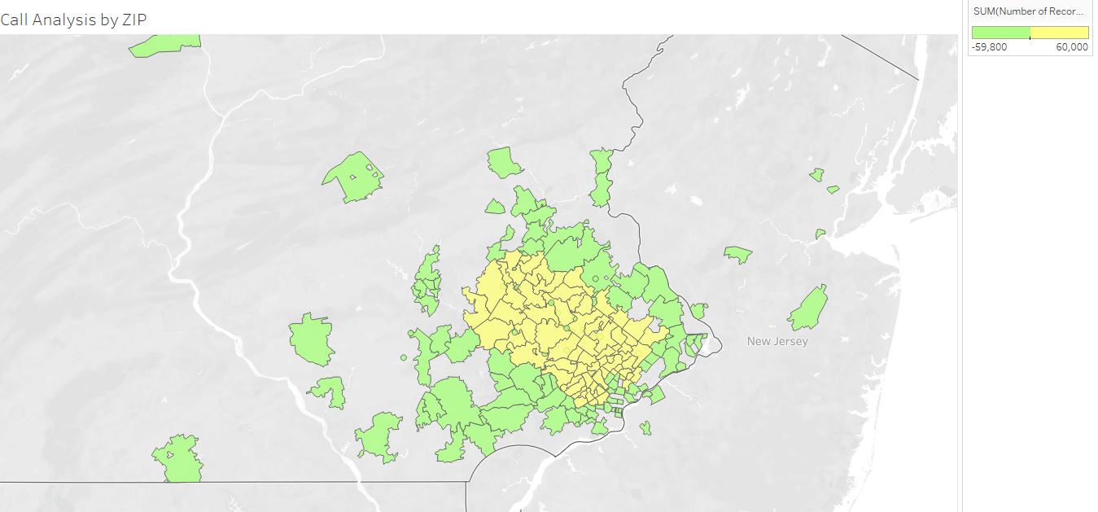
Problem Statement 6
Show the most of call received by using ZIP attribute?
Analysis
In above report we can see two colors i.e. yellow and green
Yellow → Number of calls above 100
Green → Number of calls below 100

Slide 16
Conclusion
Aim
Steps can be taken to reduce number of calls
Try to repair potholes or quality of roads.
Apply traffic signals and appropriate traffic rules to control traffic related issues.
The police officers should make rounds at night to reduce robbery and night safety related issues.
For EMS issue , try to conduct public session which provide healthy / Nutritious food information.
Spared the awareness of gym or any kind of exercise for fitness.
Fire Extinguishers are required at prominent places.
Hose reel, Wet Riser, Down comer, Sprinkler systems, courtyard hydrant, Smoke and Fire Alarm System (manual or automatic) may be required.
Try / need to apply some kind of solution or Measures to reduce number of calls

Slide 17
Google Map Link: https://www.google.co.in/maps/@40.1932423,-75.0321961,11.79z?hl=en Dataset Link : https://www.kaggle.com/mchirico/montcoalert Project Video Link: https://drive.google.com/file/d/1bWj9fCmPFvIYOEi94j1A1CkD5FyXOkjS/view?usp=sharing Tableau Link: https://drive.google.com/file/d/17lzR5yfa5ht3s-wBpeSn8QCiwiR1S5wV/view?usp=sharing
Reference

Slide 18


